Slide 1
The Research Lodge
Royce Myers
WM, Alexandria Lodge of Research and study #2

Slide 2
I know you have questions
What is a Research Lodge?
What do we talk about?
Why Join?
How do I join?

Slide 3
What is a Research lodge?
A Blue lodge makes masons.
A research lodge makes researchers.
Notes:
A research lodge is a real lodge, with a real charter, that is devoted to Masonic research. It does not confer degrees. Membership is limited to master masons in good standing, and only by plural membership.

Slide 4
What do we talk about?
Organizational issues, like membership in the fraternity
Detailed examination of ritual
Esoteric topics
History
We do not discuss ritual from appendant bodies
Notes:
After getting your third degree, did you ever wonder “Is that all? Did I miss something?” Research lodges offer a safe place to gain a deeper understanding of our craft. Members must keep an open mind, and be able to entertain an idea without necessarily accepting it.

Slide 5
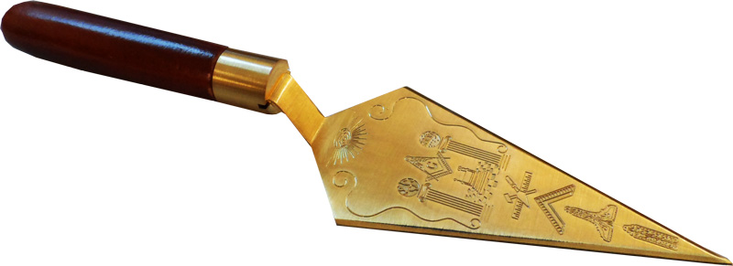
Mini example (intro)
Notes:
The third degree tells us about the cement of human kindness which unites a structure into a unified whole. There’s another part of the ritual that tells us how to make that cement.

Slide 6
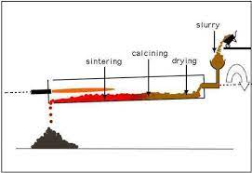
Mini example (Continued)
Notes:
In operative masonry, cement is made from limestone and clay, heated to 900 degrees.

Slide 7
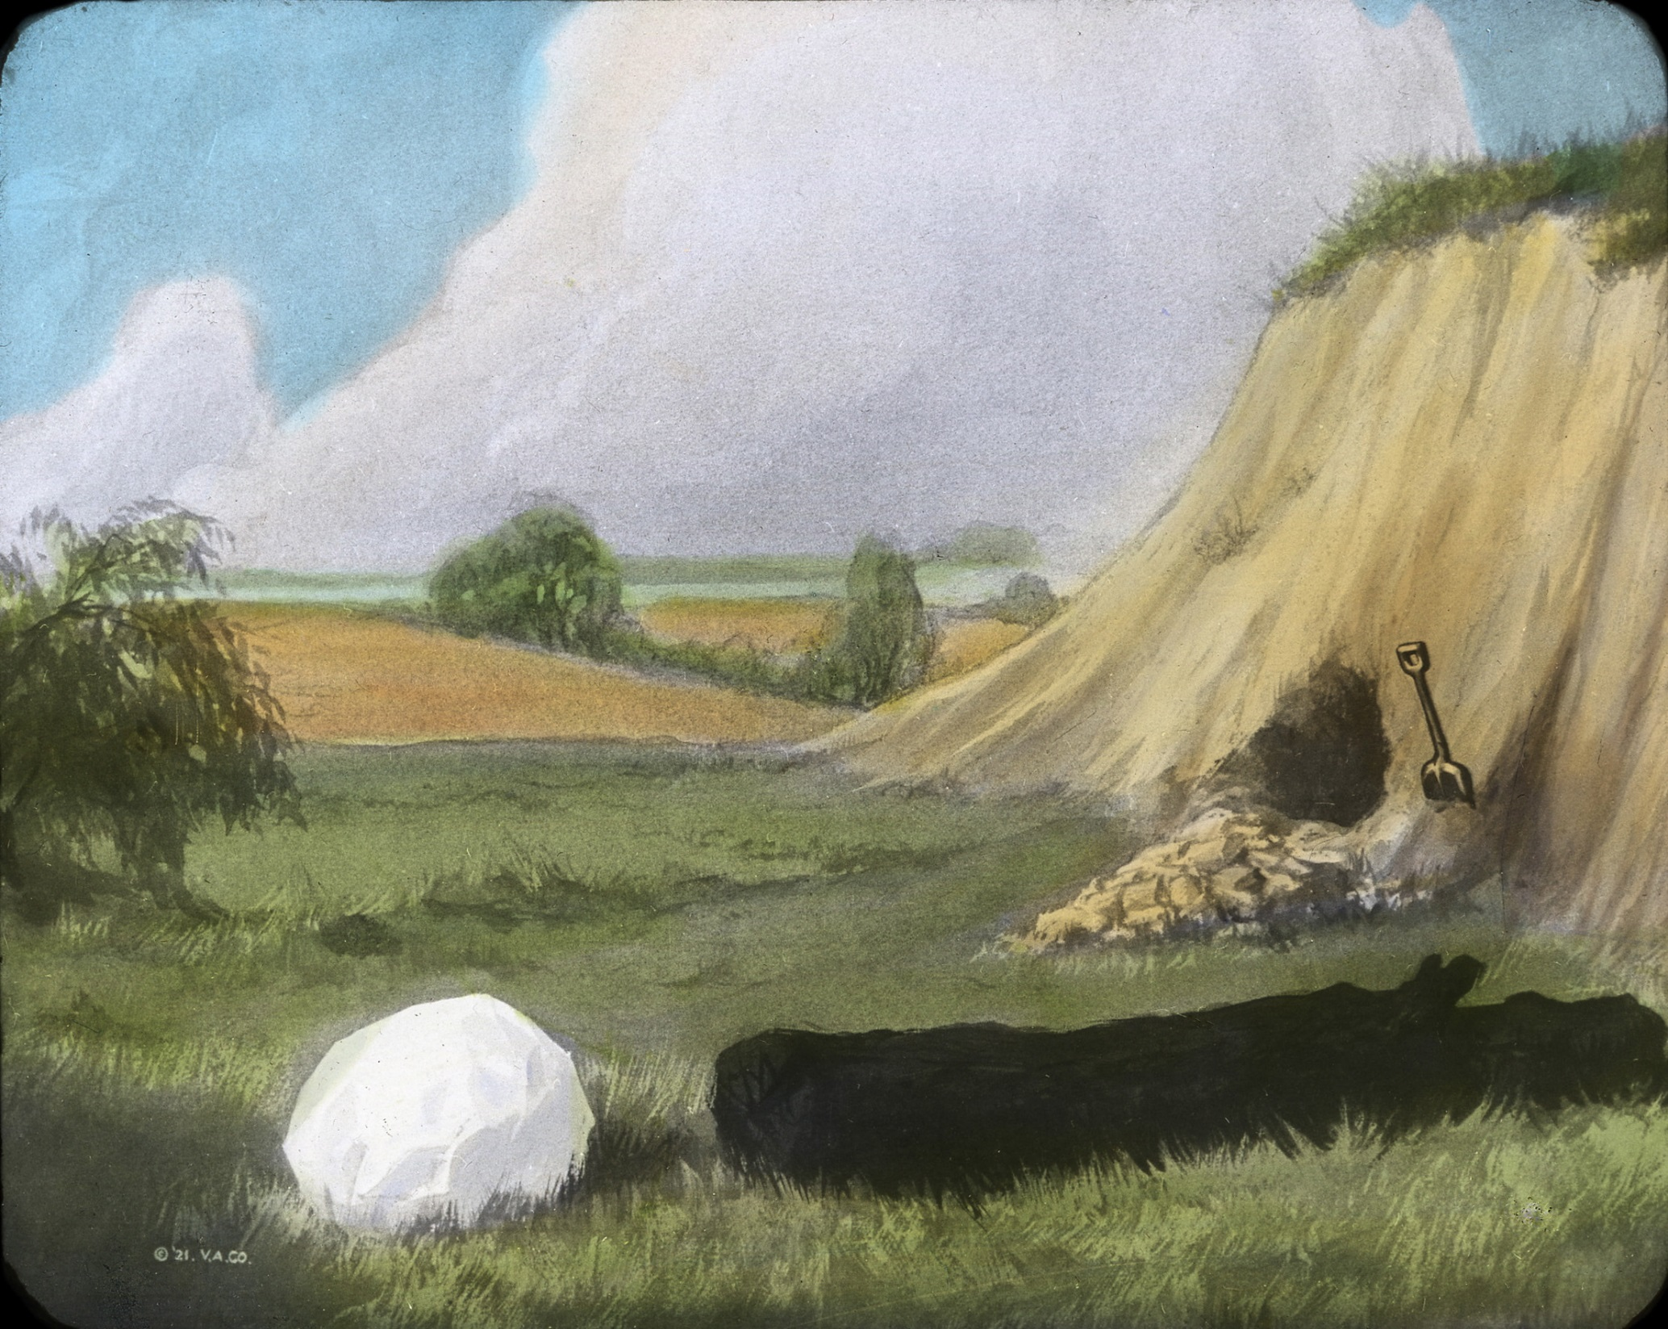
Mini Example (conclusion)
Notes:
Chalk was made from limestone. Charcoal burns at 900 degrees. In the EA Lecture we learn that chalk, charcoal and clay represents freedom, fervency and zeal. We could conclude, then, that the ritual is telling us that serving the lodge with freedom, fervency and zeal will cement our lodge into a united structure.

Slide 8
Esoteric Topics
Hermeticism
Kabbalah
Tarot
Alchemy
Notes:
Many masonic writers have tied masonic teachings to esoteric topics, like Albert Pike and Manly P. Hall. Some masons find deeper meaning in the ritual when they study these topics as well.

Slide 9
Masonic History
George Washington joined his lodge several years before it had a charter.
Mozart wrote music specifically for masonic ritual
Utah is the beehive state because of the third degree
Masons used gavels for meetings before they were used in courts

Slide 10
Why join a Research Lodge?
Notes:
The research lodge gives you a place to listen, participate and learn about masonic topics in a group of open minded people. And you can wear a really cool apron during the meetings.

Slide 11
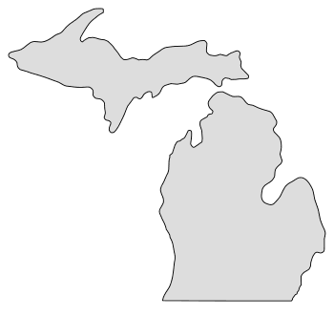
How to Join
4
3
2
1
Notes:
There are four research lodges – Detroit, Grand Rapids, Lansing and Marquette. Any master mason can attend a research lodge meeting, and petitions for plural membership are available on the grand lodge website or from the lodge secretary. The process for associate membership is the same for any plural member, and moving from associate to full membership happens after a member gives a presentation.

Slide 12
Questions

