Slide 1
The Research Lodge
A Primer

Slide 2
Contents
General Information
What do we talk about?
Why join?
How do I join

Slide 3
General Information
A Research lodge is a particular type of Masonic lodge which is devoted to Masonic research.
It is a lodge, and as such has a charter from the Grand Lodge of Michigan.
It does not confer degrees.
It restricts membership to Master Masons.
Any Master Mason can attend a meeting.
There are 5 research lodges in Michigan – Detroit, Grand Rapids, Lansing, UP, and Traverse City.

Slide 4
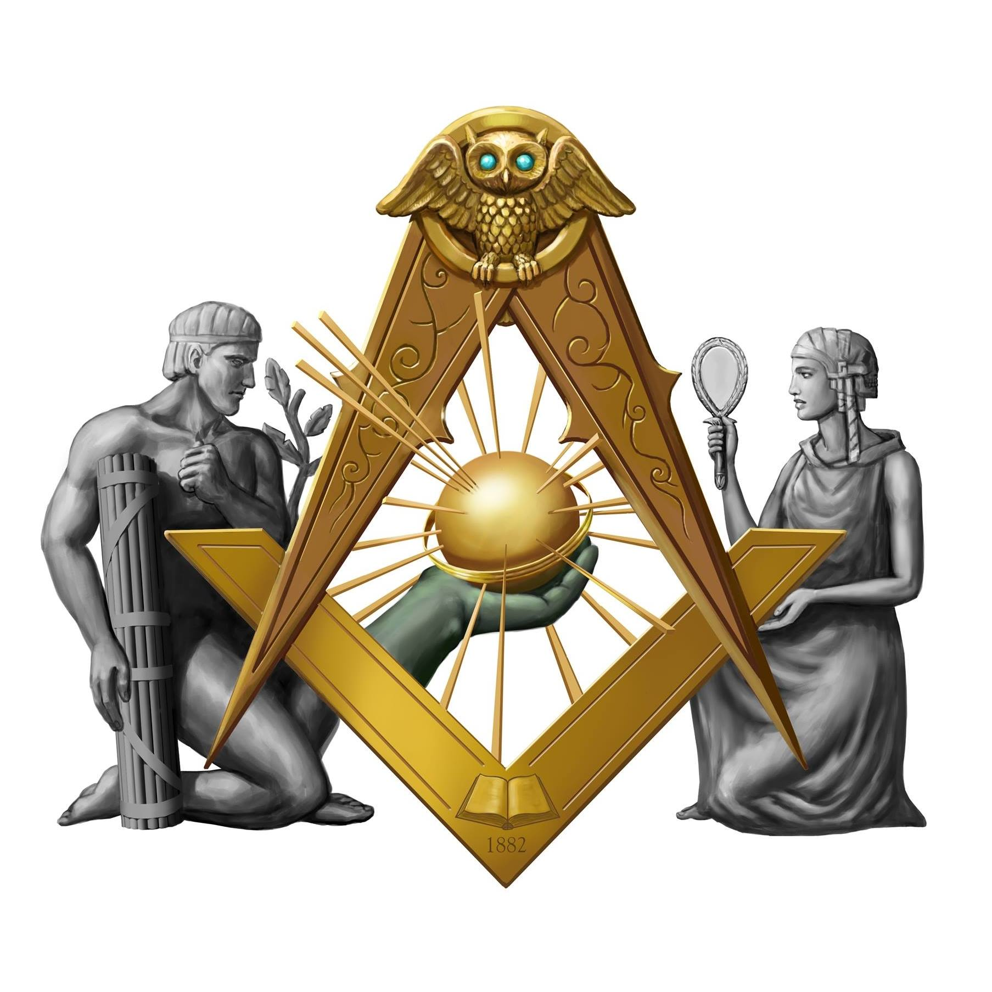
What do we talk about?
After getting your third degree, ever wonder “Is that all?” “Did I miss something?”
Research lodges offer a place to gain a deeper understanding of our craft.
Research requires an open mind, and the ability to consider an idea, without necessarily accepting the idea.

Slide 5
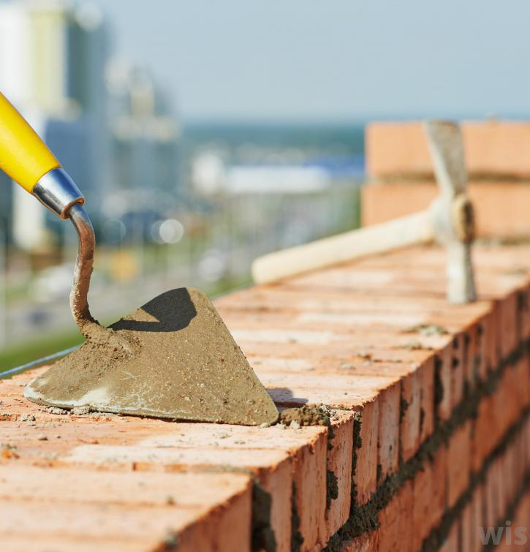
Mini Example
In the third degree, we learn about the cement of human kindness which unites a structure into a unified whole.
In operative masonry, cement is made by putting limestone and clay into a kiln and heating it to 900 degrees.

Slide 6
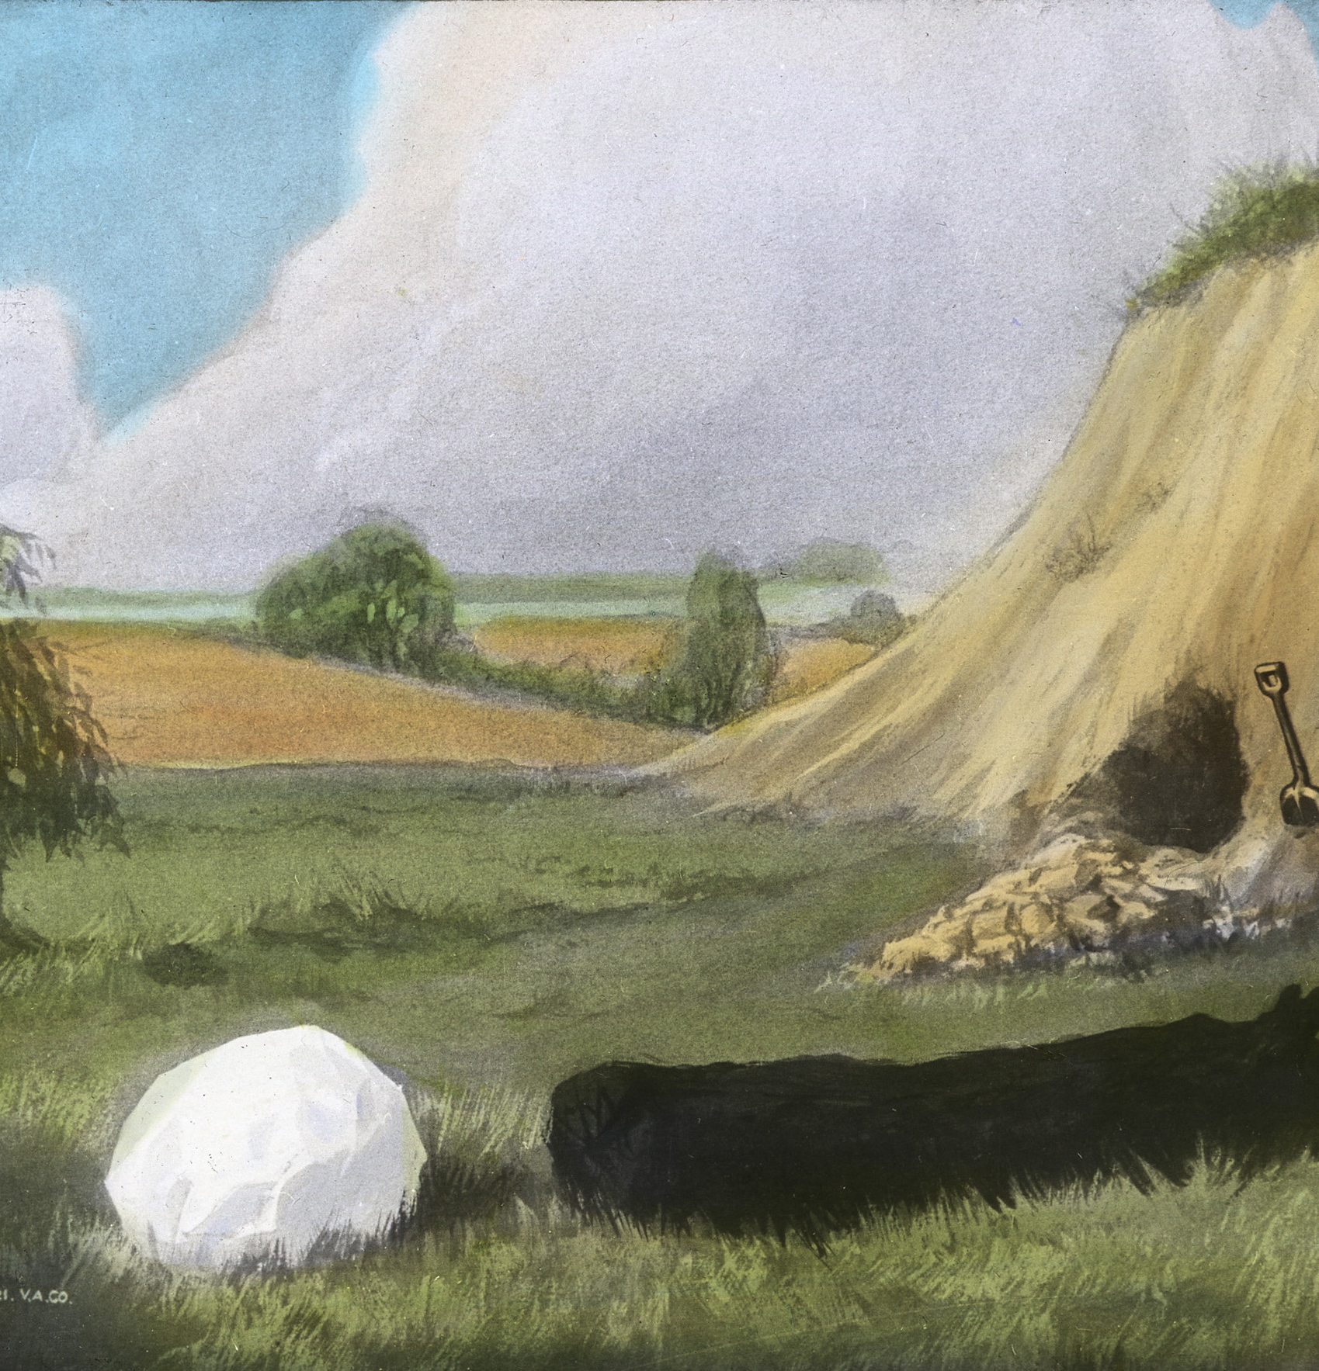
Mini Example - conclusion
In the first degree, we are given instructions for making cement: Chalk, which was made from limestone, Charcoal, which burns at 1100 degrees, and Clay.
These represent Freedom, Fervency, and Zeal.
The ritual is telling us that by serving each other with freedom, fervency and zeal, we can unite with a common purpose.

Slide 7
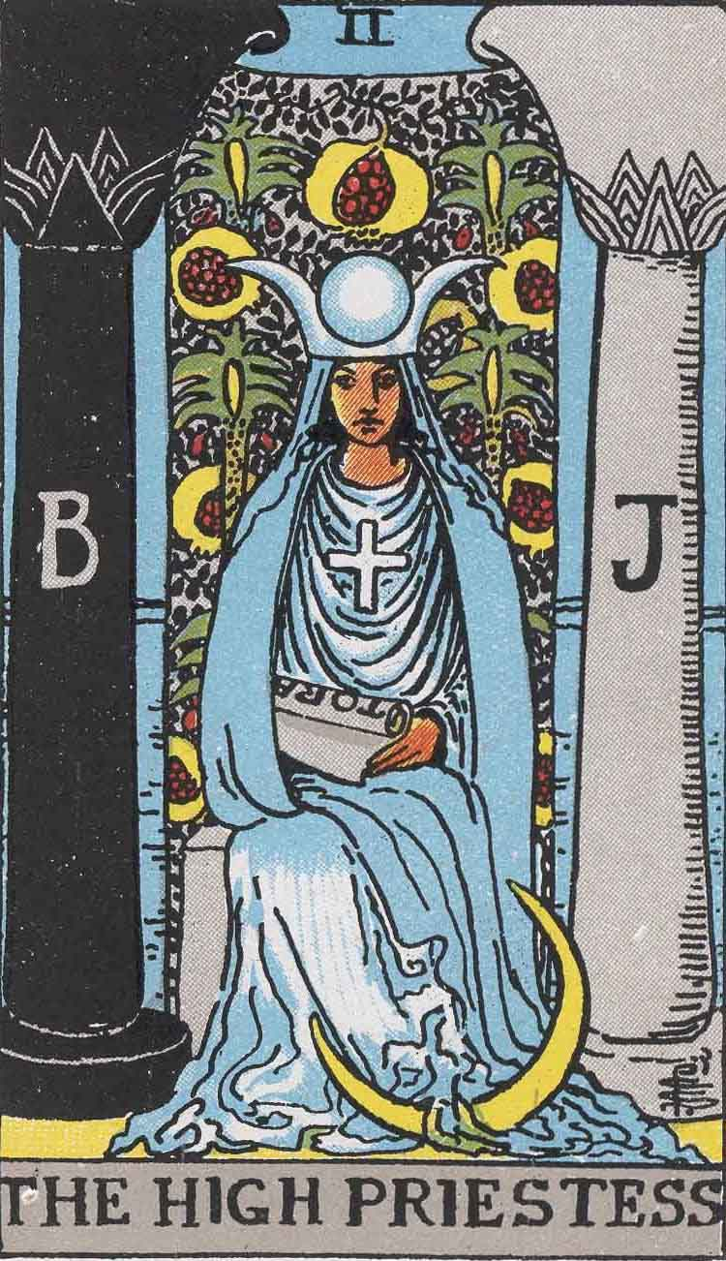
Tarot
Do you see any masonic images in this card?
Are you curious why they are there, and what they represent?

Slide 8
Alchemy
Speculative alchemy treats turning base metals into valuable metals as a metaphor for improving the alchemist.
This is very similar to the goal of masonry, which uses the metaphor of the rough ashlar and the perfect ashlar instead of lead and gold.
Studying the process of Alchemy can bring insights into the masonic process.

Slide 9
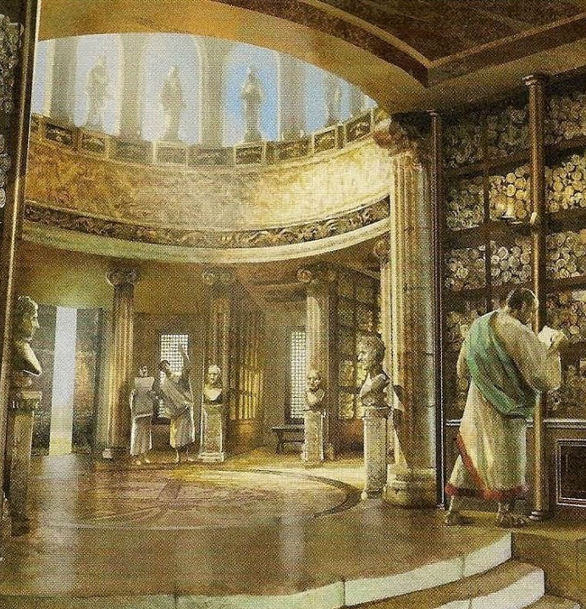
History
When George Washington joined his lodge, it had no charter, making the first years of his journey clandestine.
Mozart wrote music specifically for masonic ritual.
Utah is the beehive state, and it derives that symbol from the third-degree lecture.

Slide 10
Why Join?
Support
Support Masonic Education
Explore
Explore different ways to understand our craft
Bling
Be able to wear a unique and cool apron during meetings

Slide 11
How to join
Associate Members can be any master mason.
Full members have presented original research at ameeting

